Slide 1



Kaggle Winner Presentation (3rd) Kaggle NeurIPS 2025 Polymer Prediction Solution Presentationhttps://www.kaggle.com/competitions/neurips-open-polymer-prediction-2025
hongyu Guo&youheng Yan
Notes:
Recommending picking out he most interesting and important parts from your documentation.

Slide 2
Agenda

Slide 3
Agenda
Background
Summary
Feature selection & engineering
Training methods
Important findings
Simple model
Solution Overview

Slide 4
Background

Slide 5
Background
Background
Guo Hongyu – Computer Science Undergraduate, Huazhong University of Science and Technology
Systematic self-study in Machine Learning and Deep Learning.
Proficient with PyTorch and PyTorch Geometric for building Graph Neural Networks.
Implemented the core GATv2 model, training pipeline, and final inference logic.
Designed the key winning strategies for this competition:
Chemical Data Augmentation (Repeat Unit Expansion)
Task-Specific Hybrid Feature Engineering
Yan Youheng – Software Engineering Undergraduate, Northeastern University
Contributed to data mining and initial exploratory data analysis.
Joined the competition out of a strong interest in learning practical AI applications.

Slide 6
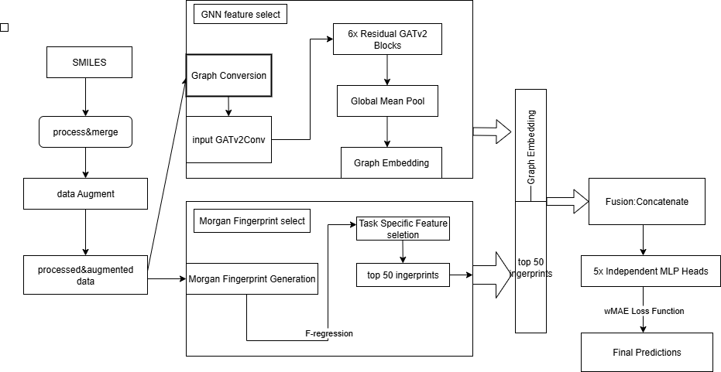
Summary
Graph Embedding:384outputs.
5 MLP for 5 property but use wMAE as loss function

Slide 7
Summary
Model Architecture
Core GNN Backbone: Each GATv2Conv layer utilizes 8 Attention Heads, allowing the model to focus on different neighborhood information patterns simultaneously.The GNN's hidden dimension is 384. With 8 heads, each head processes a 48-dimensional feature space (384 / 8 = 48).
Residual Connections are implemented via simple element-wise addition, enabling stable training of the 6-layer deep network.
Feature Fusion Architecture: The fusion of global and local features is a critical step. We use simple but effective concatenation.
| Graph Embedding (384 dims) | Top 50 FP (50 dims) |
Independent MLP Prediction Heads:
Following the fusion layer, each of the 5 target properties has its own dedicated prediction head.
Each head is a 2-layer MLP with a ReLU activation and Dropout for regularization:
Linear(in=434, out=384)
ReLU()
Dropout(p=0.2)
Linear(in=384, out=1)
Key Winning Strategy: Task-Specific Local Features
The use of independent feature selection for each target is crucial. For example, the top 50 fingerprints selected for Tg (related to chain mobility) might be completely different from those selected for Density (related to packing). This tailored approach significantly outperforms using a single, universal set of features.
Key Winning Strategy: Task-Specific Local Features
The use of independent feature selection for each target is crucial. For example, the top 50 fingerprints selected for Tg (related to chain mobility) might be completely different from those selected for Density (related to packing). This tailored approach significantly outperforms using a single, universal set of features.

Slide 8
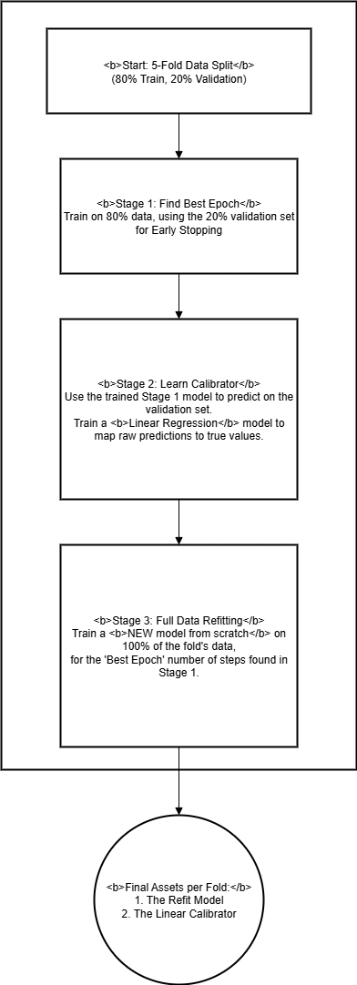
Summary
Training Pipeline
Robust Ensembling with 5-Fold Cross-Validation:
The final submission is a simple average ensemble of the predictions from the 5 models. Each model is given an equal weight of 20%.
Training Hyperparameters & Optimization:
Optimizer: We use AdamW, which often provides better regularization and performance on deep learning models compared to the standard Adam.
Learning Rate: A constant learning rate of 1e-4 is used throughout the training.
Early Stopping: Training is halted if the validation wMAE score does not improve for 40 consecutive epochs (patience=40). The model from the best epoch is saved.
Batch Size: We use a batch size of 64 during training.
Custom Loss Function for Direct Metric Optimization:
We implemented a custom Weighted MAE (wMAE) Loss Function in PyTorch.
This is critical because it ensures the model's training objective is perfectly aligned with the official competition metric, leading to more direct and efficient optimization.
Post-Hoc Calibration Details:
The Linear Calibrator is a simple LinearRegression() model from scikit-learn. For each target, it learns a linear transformation (y = a*x + b) to map the GNN's raw predictions to the true values, effectively correcting simple biases.

Slide 9
Features Selection/
Engineering

Slide 10
Features Selection/Engineering
Features Selection/Engineering
Fundamental Transformation: SMILES to Graph Representation
We convert 1D SMILES strings into rich graph structures where atoms are nodes and bonds are edges.
Node features include atomic number, degree, hybridization, etc. (7 features total).
This allows our GNN model to learn directly from the polymer’s 2D topology, capturing complex structural information.
Key Engineering Step: Chemical Data Augmentation
We implemented a function to programmatically extend monomer repeat units (*A* -> *A-A-A*).
This creates a larger and more realistic training set, forcing the model to learn features from longer, more representative polymer chains, which significantly boosts generalization.
Winning Strategy: Hybrid & Task-Specific Feature Selection
We combine two feature types: learned global embeddings from the GNN and curated local features from Morgan Fingerprints.
For each of the 5 targets, we independently select the Top 50 most predictive Morgan Fingerprints using F-regression, creating a tailored feature set for each prediction task.

Slide 11
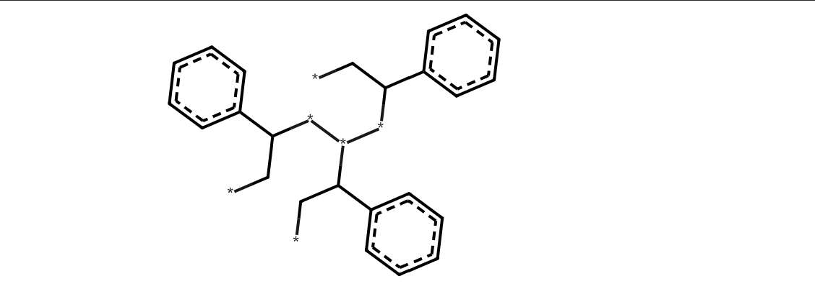
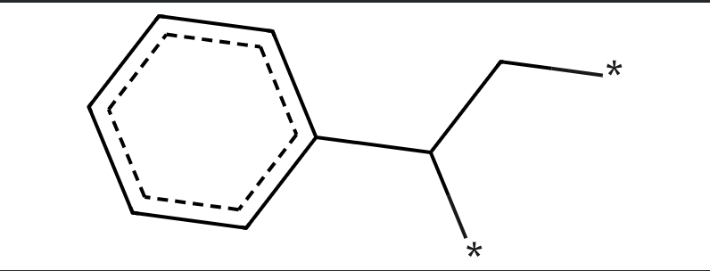
Features Selection/Engineering
Key Engineering Step: Chemical Data Augmentation
We implemented a function to programmatically extend monomer repeat units (*A* -> *A-A-A*).
This creates a larger and more realistic training set, forcing the model to learn features from longer, more representative polymer chains, which significantly boosts generalization.
e.g.
Original SMILES (Monomer): *C(c1ccccc1)C*
Augmented SMILES (Trimer): *CC(**(*C(C*)c1ccccc1)C(C*)c1ccccc1)c1ccccc1

Slide 12
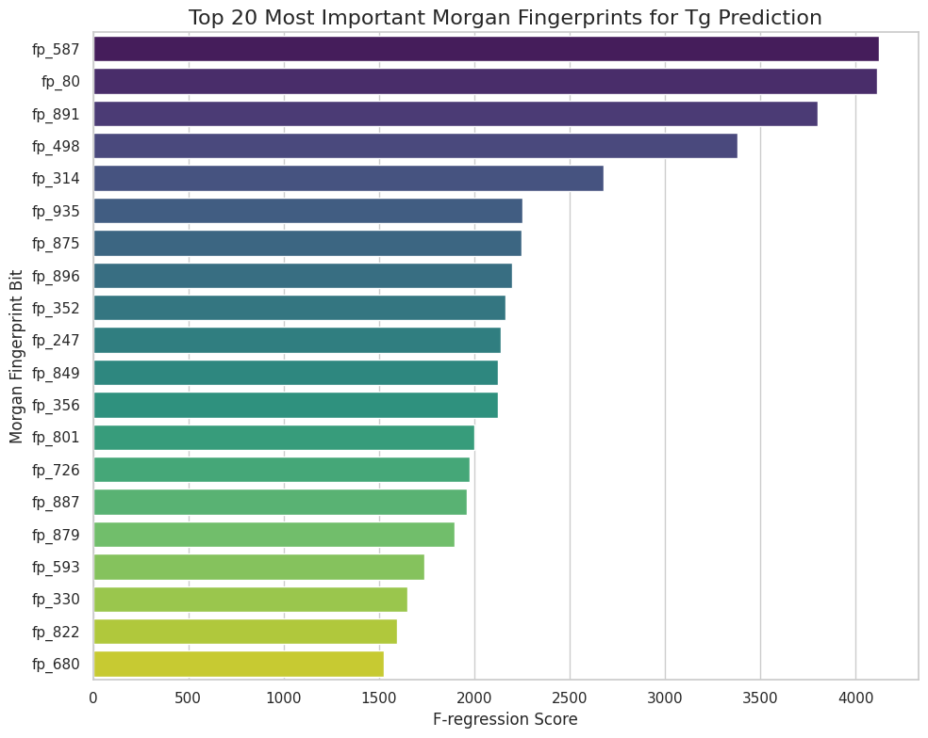
Features Selection/Engineering
Features Selection/Engineering
Variable Importance Plot
Most Important Features: Top 20 Morgan Fingerprints for Tg
We used F-regression to score all 1024 Morgan Fingerprint bits against the Tg target, identifying the most predictive chemical substructures.
The plot visualizes the Top 20 bits with the highest scores. These bits, such as fp_587 and fp_80, represent the most influential local chemical features for Tg prediction.
This data-driven selection process allowed us to create a compact and powerful 50-feature set for the Tg prediction head, instead of using the full noisy 1024-bit vector.

Slide 13
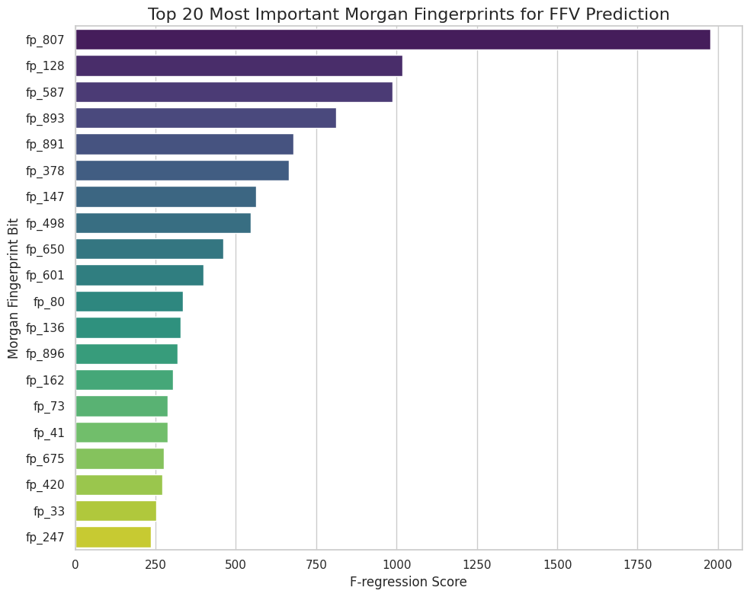
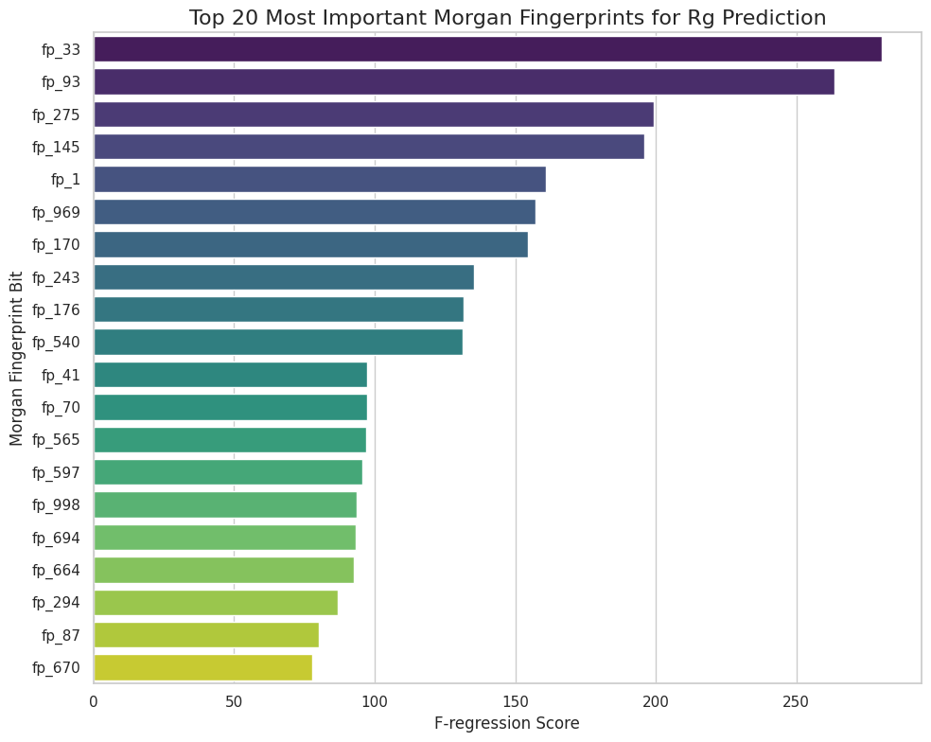
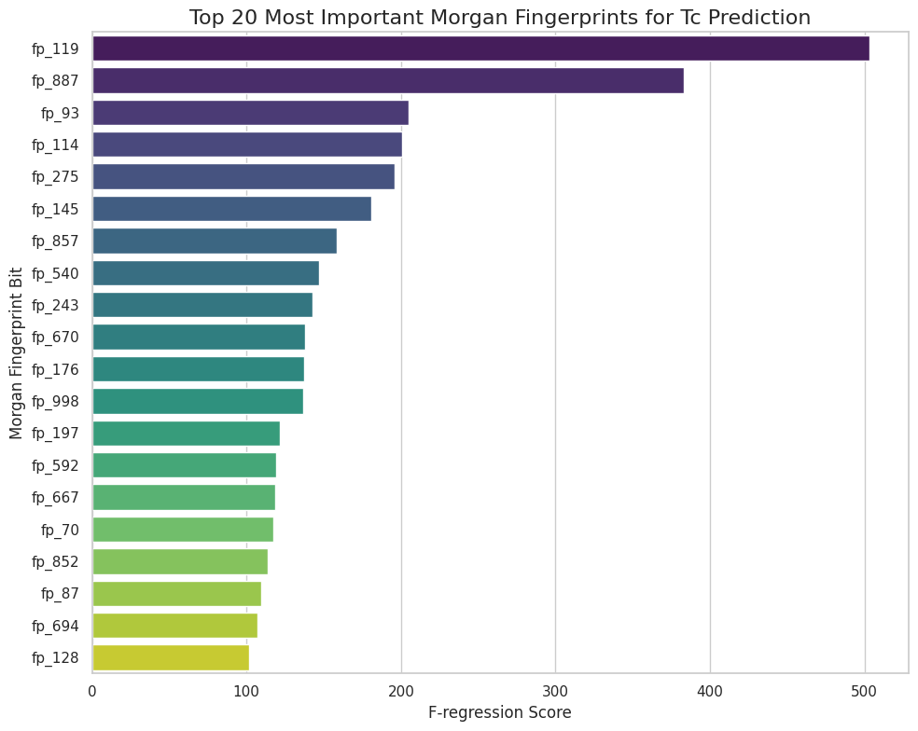
Features Selection/Engineering
Features Selection/Engineering
Variable Importance Plot

Slide 14
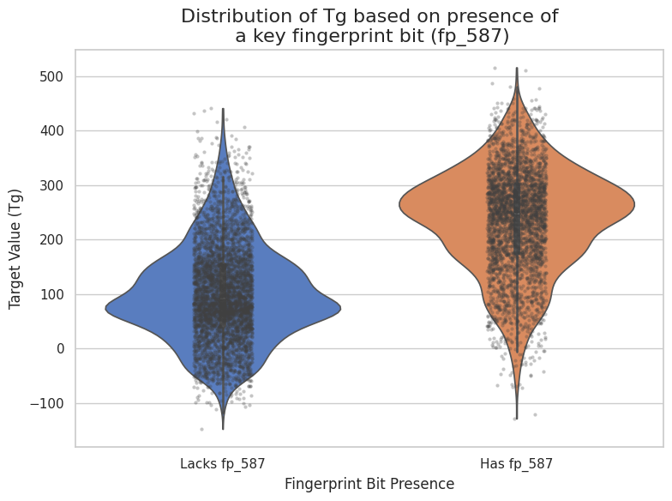
Features Selection/Engineering
Relationship to Target: Impact of the Top Feature (fp_587) on Tg
To visualize the impact of our most important feature, we compared the Tg distributions for two groups of polymers: those that possess the fp_587 fingerprint bit and those that do not.
The violin plot clearly shows a significant positive correlation: polymers with the fp_587 substructure have a markedly higher median Tg (approx. 280°C vs 150°C).
This strong visual evidence validates our feature selection method and confirms that our model is learning meaningful chemical relationships.

Slide 15
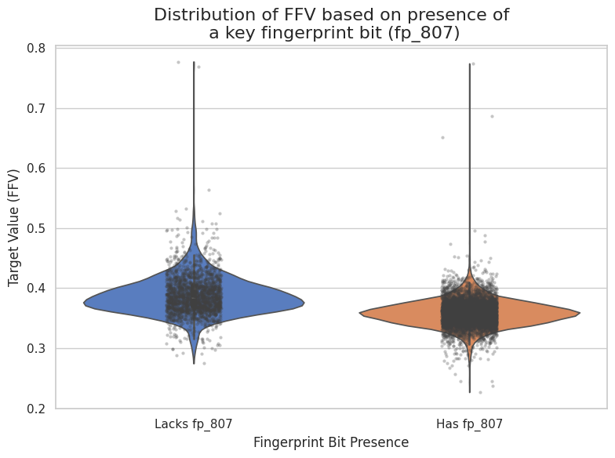
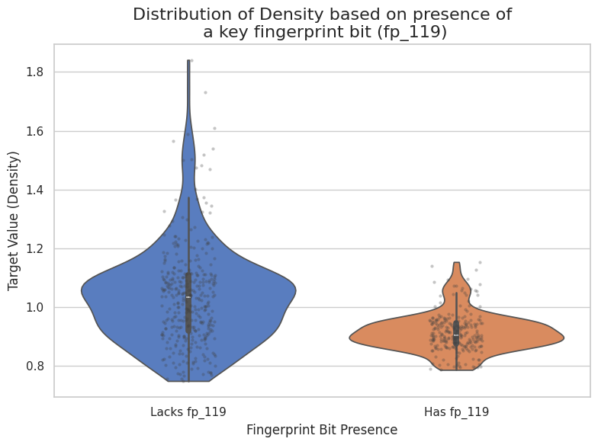
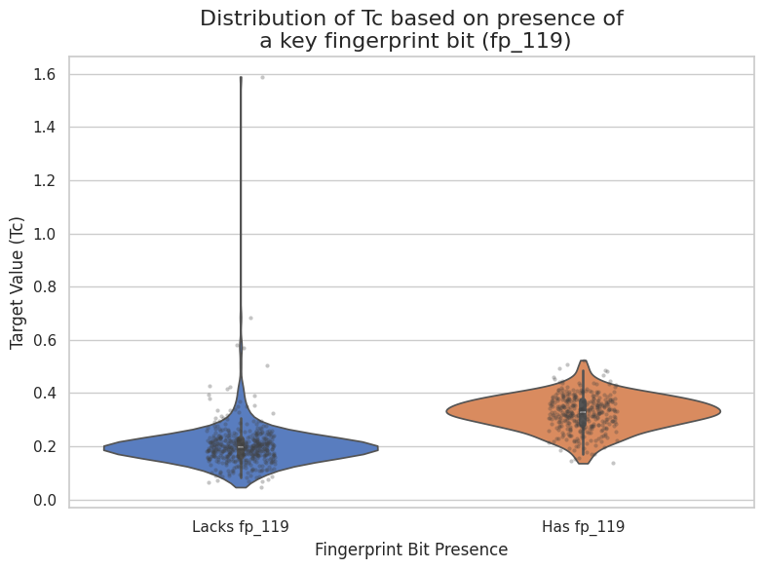
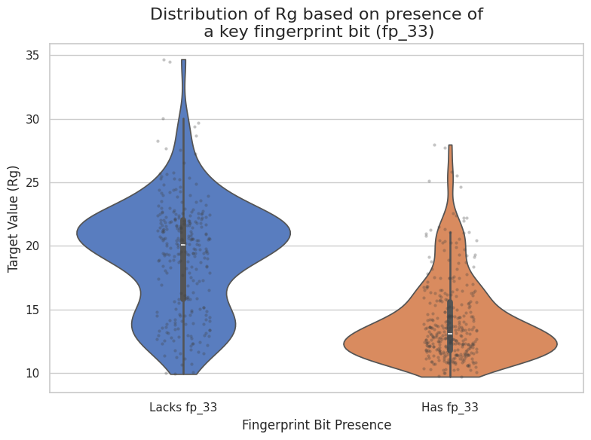
Features Selection/Engineering

Slide 16
Training Methods

Slide 17
Training Methods
Custom Weighted MAE Loss with AdamW Optimizer.
We implemented a custom loss function in PyTorch that perfectly mirrors the official wMAE competition metric. This ensures the model directly optimizes for the final score.
AdamW optimizer was used with a constant learning rate of 1e-4.
Robust 5-Fold Cross-Validation Ensemble.
The final solution is a simple average ensemble of 5 models trained on different 80/20 splits of the data.
Batch size of 64 was used during training.
Two-Stage Training with Early Stopping & Refitting.
Stage 1: Find Best Epoch. We train on 80% of the data and use the remaining 20% as a validation set for Early Stopping (patience=40), preventing overfitting.
Stage 2: Refit on Full Data. A new model is then re-trained from scratch on 100% of the fold's data for exactly the best number of epochs found in Stage 1. This maximizes data utilization for each final model.
Post-Hoc Linear Calibration.
After training, a simple LinearRegression model is fitted for each target on the validation set's predictions. This effectively corrects any systematic bias from the GNN model, providing a final small but crucial boost in performance.
Kaggle Winner Presentation Template

Slide 18
Important and Interesting Findings

Slide 19
Important and Interesting Findings
Finding 1: Polymer Chain Extension is Superior to Isomer Generation
We experimented with two distinct data augmentation strategies.
Strategy A (Chain Extension): Simulating polymerization by extending monomer repeat units (*A* -> *A-A-A*). This was highly effective.
Strategy B (Isomer Generation): Creating multiple different but chemically valid SMILES strings (isomers) for the same monomer. This provided no performance gain.
Hypothesis: The model benefits more from seeing longer, more realistic polymer structures than from seeing minor variations of the same monomer. The core challenge lies in understanding chain interactions, not monomer ambiguity.
Augmentation Strategy | PB Score (wMAE) | Finding
No Augmentation (Baseline) | 0.083 | Baseline
Isomer Generation Only | 0.083 | Negligible Impact
Chain Extension Only (Our Method) | 0.078 | Significant Improvement
Kaggle Winner Presentation Template

Slide 20
Important and Interesting Findings
Finding 2: The "Sweet Spot" of Batch Size - Bigger is Not Always Better
Despite having enough GPU memory for larger batch sizes (128, 256), we found that a smaller batch size of 64 consistently yielded the best results.
Larger batch sizes led to a degradation in the final PB score.
Finding 3: Surprising Synergy Between GNN Architectures and Feature Types
We tested different combinations of GNN backbones and auxiliary features. The results revealed a strong and unexpected interaction effect.
GATv2 + Morgan Fingerprints was the clear winner.
Interestingly, RDKit Descriptors hurt the performance of GATv2 a lot, but helped the performance of NNConv a little.
Models | Features selested | PB Score
GATv2Conv | Morgan Fingerprints(50) | 0.078
GATv2Conv | RDKit Descriptors(50/36/0) | 0.182/0.102/0.087
NNConv | Morgan Fingerprints(50) | 0.080
NNConv | RDKit Descriptors(36/0) | 0.084/0.087
Kaggle Winner Presentation Template

Slide 21
Important and Interesting Findings
Hypothesis:
GATv2's attention mechanism already captures complex, high-level geometric and chemical environments. The simple, bit-based Morgan Fingerprints provide complementary, low-level substructure information without creating conflicting signals.
NNConv, being a simpler message-passing network, may benefit more from the pre-computed, human-engineered RDKit Descriptors, which provide it with high-level chemical concepts it struggles to learn on its own.
Finding 4: Systematic Bias Correction via Post-Hoc Calibration
Analysis of our Out-of-Fold (OOF) predictions across all 5 folds revealed a consistent, systematic bias: the model's raw predictions (blue line) consistently overestimate low Tg values and underestimate high Tg values.
This distribution shift is a common challenge, and correcting for it was key to maximizing our score.
Kaggle Winner Presentation Template

Slide 22
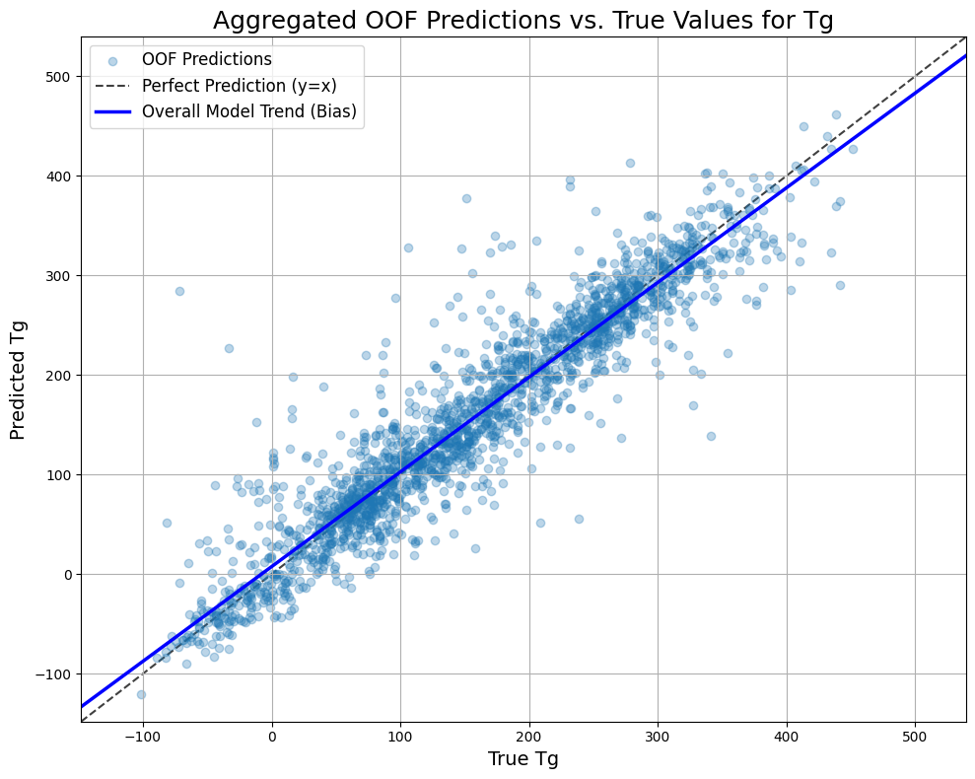
Important and Interesting Findings
Finding 4: Systematic Bias Correction via Post-Hoc Calibration
Analysis of our Out-of-Fold (OOF) predictions across all 5 folds revealed a consistent, systematic bias: the model's raw predictions (blue line) consistently overestimate low Tg values and underestimate high Tg values.
This distribution shift is a common challenge, and correcting for it was key to maximizing our score.
Metric | wMAE (before Calibration) | wMAE (after Calibration) | Improvement
Overall OOF Score | 0.135932 | 0.128494 | 5.47%
Our Solution: Universal Linear Calibration
We found this bias can be effectively corrected with a simple LinearRegression model fitted on each fold's validation predictions.
As shown in the table, this simple post-hoc step provides a significant 5.47% improvement to the final wMAE score. It's a small change that makes a crucial impact.Our PB Score from 0.080 to 0.078
Kaggle Winner Presentation Template

Slide 23
Simple Model

Slide 24
Simple Model
Our GNN Backbone is Powerful Enough on its Own.
To understand the contribution of each component, we evaluated several simplified versions of our final model.
A single model (1-fold) without ensembling already achieves a very competitive score.
Model Configuration | Private LB wMAE | Key Takeaway
Final Solution (5-Fold Ensemble) | 0.078 | Best performance & robustness
Single Model (1-Fold, GNN + FP) | 0.085 | Ensembling provides a crucial boost
Single Model (1-Fold, GNN Only) | 0.087 | GNN backbone is the main driver of performance
Single Model (1-Fold, GNN+FP but removeHs) | 0.083 | After the competition I tested
Post-Competition Finding: The Untapped Potential of RemoveHs
After the competition ended, we tested a simple change in the data preprocessing step: removing hydrogen atoms (RemoveHs in RDKit) before graph conversion.
Surprisingly, a single model trained with RemoveHs achieved a Public LB score of ~0.083, which is even better than our single model with hydrogens.
Conclusion: This suggests that if we had applied the RemoveHs preprocessing to our full 5-fold ensemble pipeline, our final score could have been even higher. The model performs better when focusing on the heavy-atom backbone of the polymer.

Slide 25
Solution Overview

Slide 26
Solution Overview
What were the key insights you had in approaching this competition? Anything surprising?
Key Insight: Our main insight was that a hybrid approach would outperform any single method. We realized that GNNs are excellent at capturing global polymer topology, while traditional Morgan Fingerprints are better at representing specific, local chemical substructures. Fusing them was the key.
Most Surprising Finding: The surprising synergy between GNN architectures and feature types. We discovered that RDKit Descriptors actually hurt the performance of our powerful GATv2 model but helped a simpler NNConv model. This highlights that more features are not always better, and the interaction between model and feature is critical.
What gave your team the biggest advantage in this competition?
Our biggest advantage was our two-pronged feature engineering strategy:
Chemical Data Augmentation: Programmatically extending monomer chains (*A* -> *A-A-A*) created a larger, more realistic dataset that significantly improved our model's generalization.
Task-Specific Feature Selection: Instead of using a universal feature set, we selected the top 50 most predictive Morgan Fingerprints independently for each of the 5 targets. This allowed our model to focus on the most relevant chemical information for each distinct property.
What was the most fun aspect of the competition for you?
The most fun aspect was the process of iterative discovery and validation. It was incredibly rewarding to form a hypothesis, like "longer polymer chains should improve the model," then implement the data augmentation to prove it, and finally see the tangible improvement in our CV score. It felt like we were conducting real scientific research, bridging the gap between chemical intuition and machine learning.

Slide 27
Question and Answer

